Slide 1


The Problem
Inadequacy of Health Resources
Inequitable Access to Health Service
Uneven Health Service Coverage
Information Asymmetry
Poor Governance
Absence of One Stop Service

Slide 2



Slide 3

The Solution
Give access to all the health care services in the easiest way possible with a simple and specialized mobile application. Anyone can get all kind of medical support from booking an ambulance to get emergency medicine with just a few tap on the phone.

Slide 4
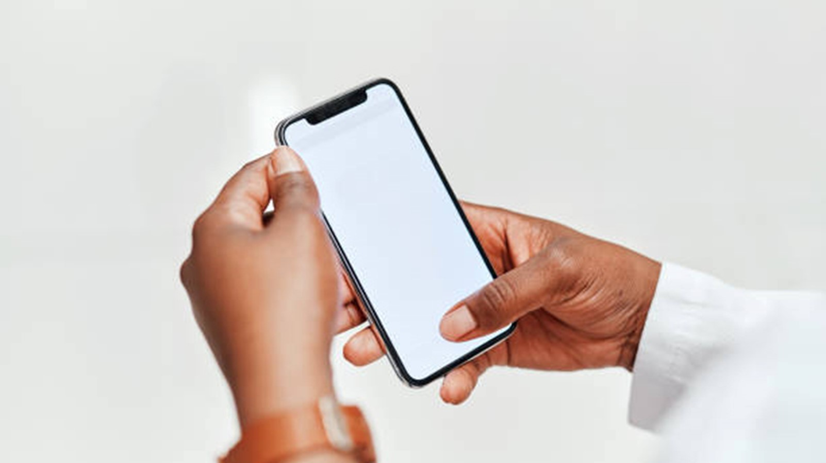
MedieNeed: The Platform
“MedieNeed”
is a mobile application that connects all the health care service seekers and service providers in a single platform.
TiGrow Ltd. | 2019

Slide 5

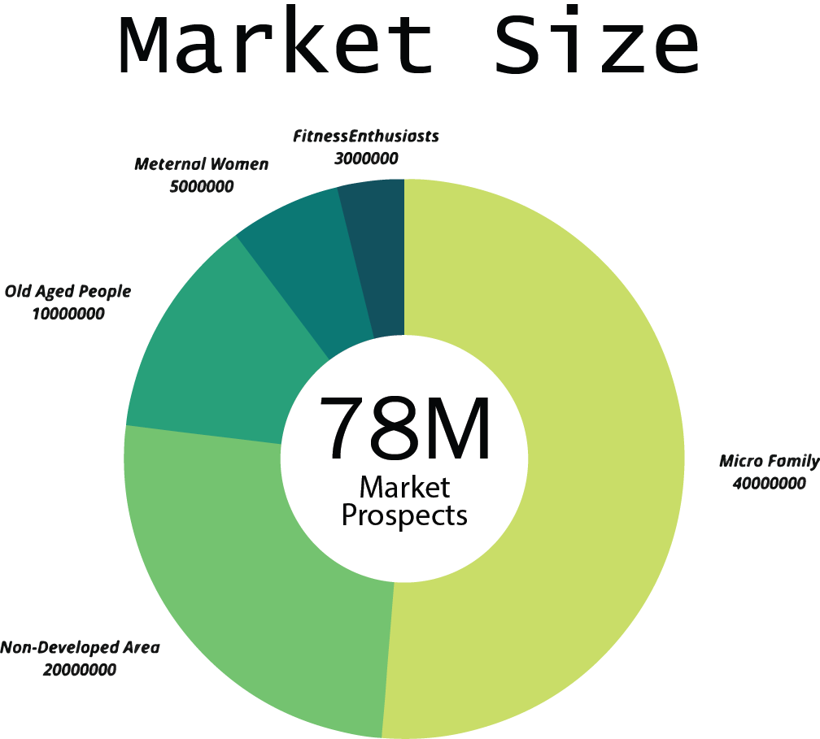
Fitness Enthusiasts
Worth $1.8 B
Meternal Women
Worth $6 B
Old Aged People
Worth $15 B
Micro Family
Worth $20 B
Non-Developed Area
Worth $2 B

Slide 6



Our Services
For Service
For Service
Seekers:
Providers:
Doctors’ Appointment
Home Call Nurse & Physiotherapist
Diagnostic Service at Home
Medicine Delivery at Home
Live Chat with Doctors
Ambulance Service
Blood Search
Prescription, appointment & Schedule Management Tools For Doctors.
Necessary Analytics
Referring Customers
Promoting Products & Services
TiGrow Ltd. | 2019

Slide 7
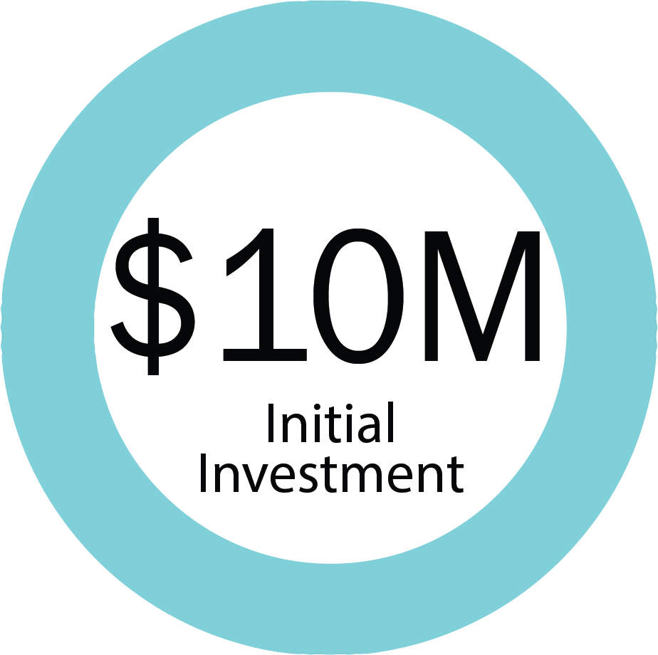
Funding Needed
We will use the money to reach out more potential users all over the country and enrich our services with own skilled team with equipment.
TiGrow Ltd. | 2019

Slide 8
Sales Channels
1. Providing diagnosis facility to doorstep 2. Monthly charge for basic consultancy. 3. Providing nurse for home care. 4. Sell medicine online. 5. Providing therapy and ambulance service
We offer the best solution possible through a mobile app. We offer a variety of services directly on our website as well. We will also have a skilled team to give medical support over the phone. Each of these method is lead to direct sales.
TiGrow Ltd. | 2019

Slide 9
Marketing Activities
1. Grand opening with offers 2. Maintain social media pages and website 3. Attend and hosting medical summit. 4. Advertise in local newspaper and media. 5. Social Media Marketing

Slide 10

Financial Estimations (USD) for 5 Years
TiGrow Ltd. | 2019

Slide 11

Our Future Events
March 31
2022
June 30
2022
December 31
2023
Pre Series A Funding
Activate All the Services
Series A Funding
Launch at Nepal
Android & ios app launch
TiGrow Ltd. | 2019

Slide 12

Barriers to Entry
1. Lack of awareness
2. Digital Divide Between Patients
& Physician
3. Policy & Governance
4. Access to finance
TiGrow Ltd. | 2019

Slide 13
CONTACT US
MAILING ADDRESS : 5/9, Block B, Lalmatia, Mohammadpur, Dhaka, 1207, Bangladesh.
EMAIL ADDRESS: ahmedulbabu@techknowgram.com
PHONE NUMBER: +880171 345 3337

